Slide 1



Slide 2


Slide 3

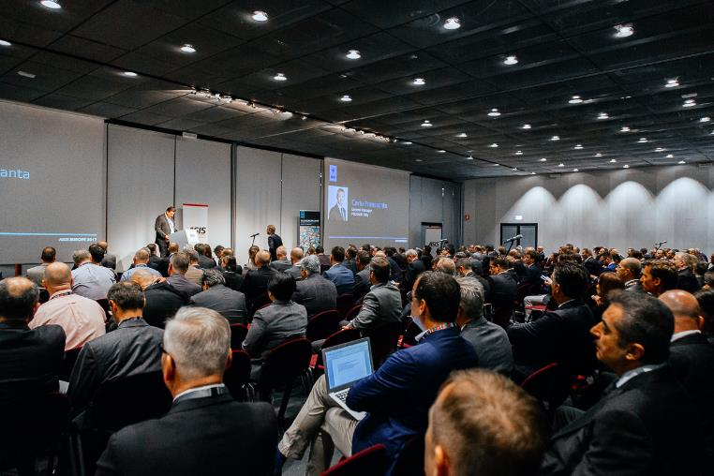
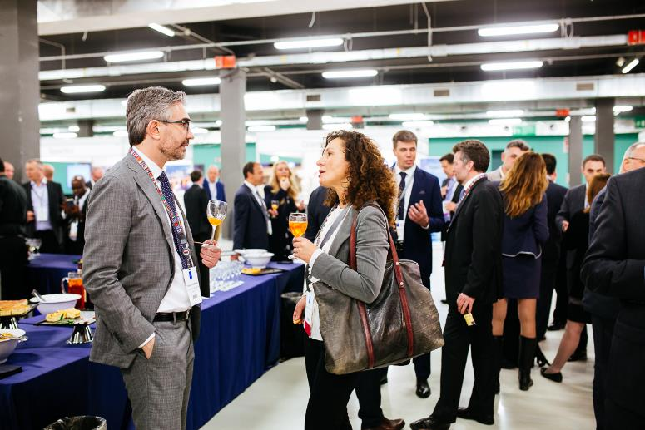
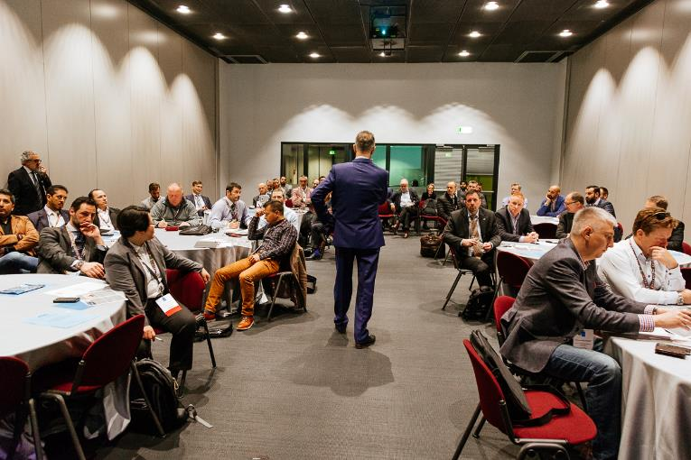
ASIS’ Flagship Event in Europe
Conference | CSO Center | Classroom Training | Exhibition| Technology & Solutions | Career Centre

Slide 4
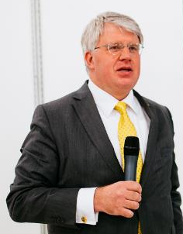
Conference Theme: Blurred Boundaries – Clear Risks
Conference chair: Eduard Emde, CPP
Overall challenge addressed: Securing today’s connected enterprise
Focus on complex cyber-physical threats, impact of IoT, big data, artificial intelligence and shifts in the value of digital vs physical assets
Tackle cyber and IoT topics from the viewpoint of security practitioners, not IT experts

Slide 5

Why the Focus on Cyber-Physical?
Help ASIS Members adapt to an IoT dominated business world
Convince the next generation of security leaders that ASIS is the right place for them to develop professionally
Support ASIS’ ESRM strategy to be the global thought-leader on emerging security risk challenges
Create a unique and vital annual gathering that adds to the local chapter value proposition

Slide 6
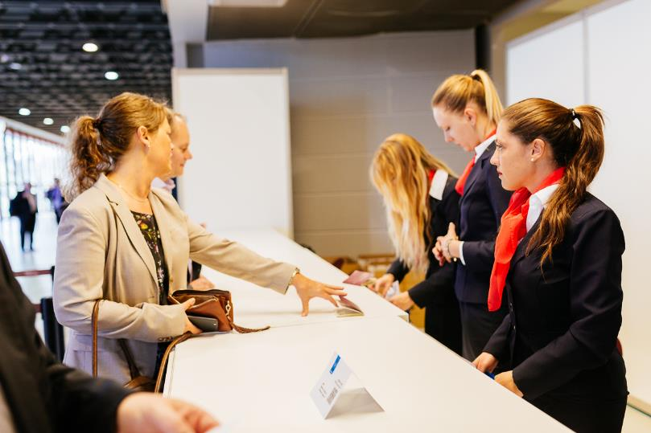
Attendance Options for all Budgets
Conference: Keynotes, Masterclasses, Executive Sessions, Training Sessions
  From €600 for 2 days, €400 for 1 day
  Discounts available for Groups of 3 or more
  Early rates until 15 November!
Training Modules: choose one or combine
  From €75 per module
Show Pass: Exhibition, Technology & Solutions Track and Career Centre
  Free online until 17 April

Slide 7
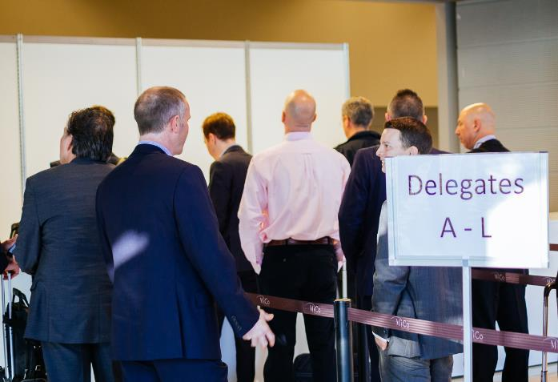
NEW Conference Offers for 2018!
Special Early Bird rates from registration opening in mid-September to 15 November : €695 / €600 (without President Reception) for ASIS Members instead of usual advance rate of €795 / €700
Chapter bonus: one complimentary registration for every 10 full conference registrations from the same chapter confirmed by 30 November
Plus: Group Discounts for 3 or more attendees from the same organisation available at any time

Slide 8
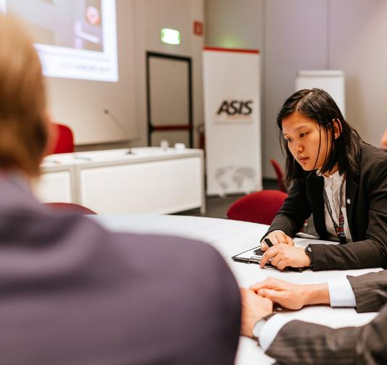
Classroom Training Topics
Soft target attacks
Crisis management
Managing travel risks
Fundamentals of Cybersecurity
Cyber-Physical security
More details later in October

Slide 9
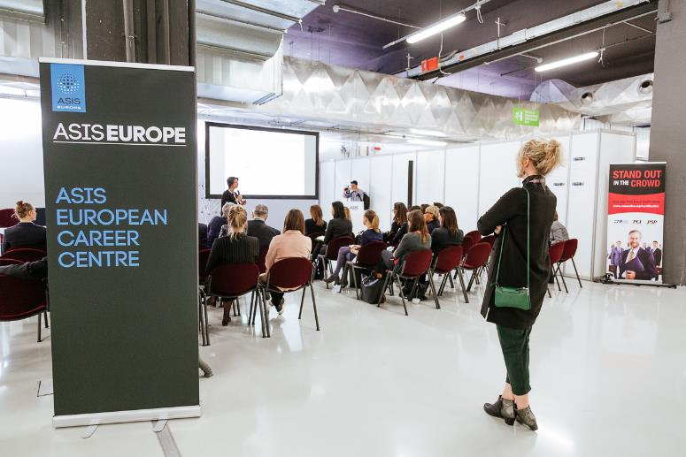
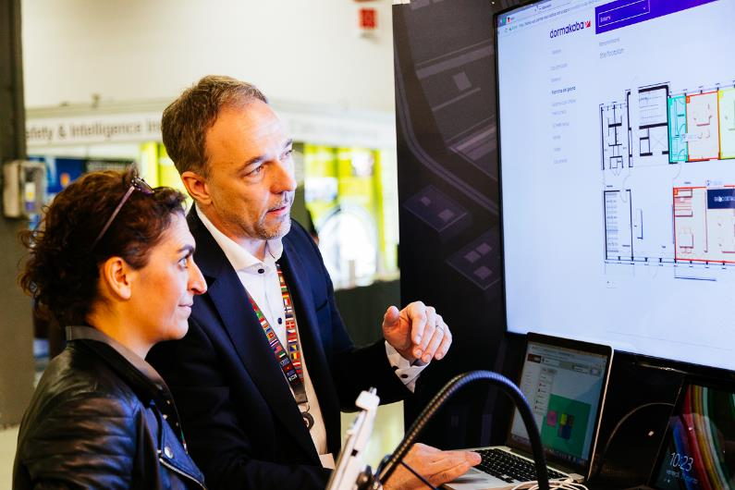
Free to Attend – Education Sessions
Career Centre
  Coaching and Advice
  Salary Survey
  Certification tips
  Support from YP and WIS
Technology & Solutions Track
  Addressing challenges raised in the conference
  Vetted educational sessions – not sales pitches

Slide 10
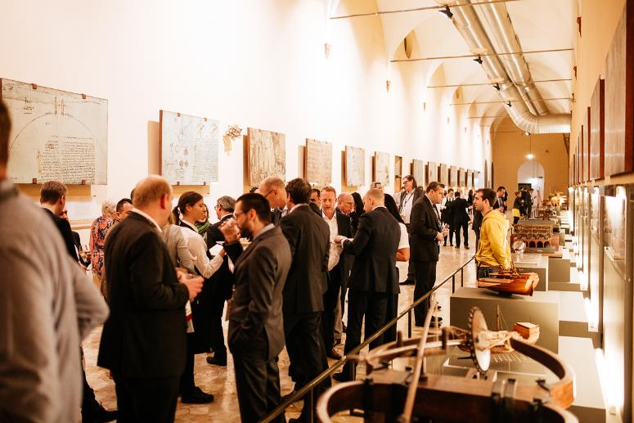
Dedicated Networking Time
For all attendees including free Show Pass
  Coffee breaks
  Borrel – happy hour in the exhibition hall on Thursday
For conference delegates only or for purchase
  Welcome Drinks
  President’s Reception
  Conference lunches

Slide 11
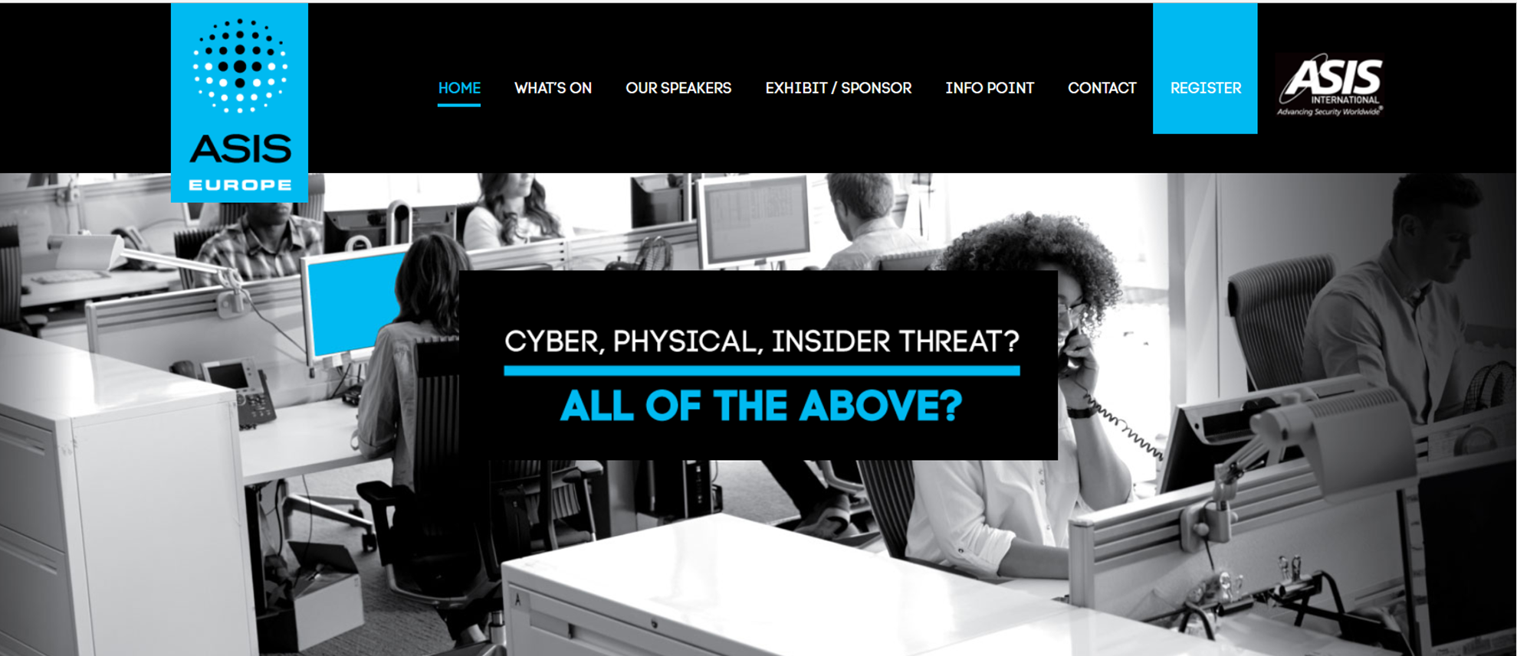
Stay up to date: www.asiseurope.org

Slide 12
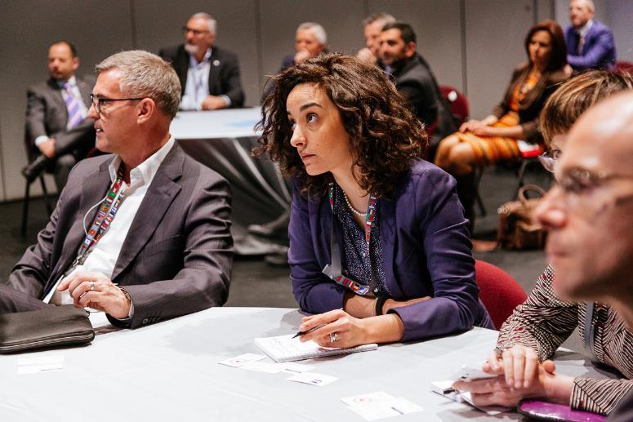
Conference Theme: Blurred Boundaries – Clear Risks
Learning for established and aspiring security leaders who have to work across silos and in new models for emerging risks
Principles of ESRM reflected throughout programme
Plus: risk outlooks, case studies, and analysis across the full range of key security management issues
Includes Conference Training Track for practical learning (same topics as Classroom Training but for a more advanced audience)

Slide 13
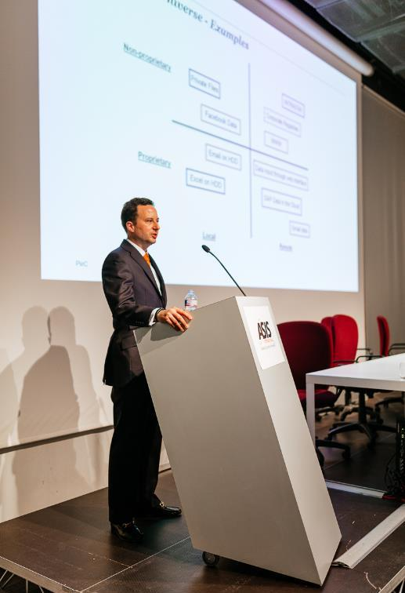
Masterclasses Confirmed
“Deep dives" into some of the most complex emerging challenges facing security practitioners today:
How Digital Asset Valuation Impacts Risk Assessments
GDPR and its Impacts on Enterprise Security
Skillsets of the Security Team Now and in the Near Future

Slide 14
Classroom Training Modules
2 hour blocks of focused, practical learning, in groups of max. 50 participants
Certificates of attendance provided
Priced to be flexible and accessible to all - €75 per module for ASIS Members / €100 for non members
Note: not included in Conference registration, targeted at less experienced professionals

Slide 15
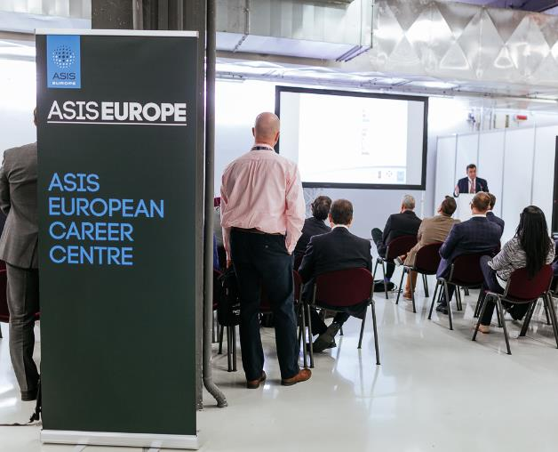
Career Centre – Free to Attend – Thursday 19 April
The Benefits of ASIS Certification
Executive Education: Effective Management for Security Professionals
How to build a winning resume
European Salary Survey
Diversity in the security profession
Transitioning from the Military and Law Enforcement

Slide 16
Career Centre – Free to Attend – Friday 20 April
A career in security: Young Professionals' stories
Preparing for a job interview
Networking for business
What are employers and recruiters looking for?
The Benefits of ASIS Certification

Slide 17
Exhibition / Technology & Solutions – Free to Attend
Solutions providers addressing the challenges raised in the conference
Dedicated Technology & Solutions Track for educational sessions – not sales pitches
Free show pass also includes coffee breaks and career centre sessions
Interested in exhibiting? Brochure on the website or contact europe@asisonline.org

Slide 18
Can’t find what you need? Contact us directly:
ASIS International Brussels Bureau
europe@asisonline.org
+32 2 318 5751

